Slide 1

Title:NFHS-5 India District /state/UT Health Dashboard Dataset
Name: National Family Health Survey (NFHS-5) Districts Factsheet Data
Team Name: BI Curious
Team Members: Deepak Kumar, Sonam Bharti, Nafiah Eqbal, Archi Verma, Ambrish Dubey
Tool Used: Microsoft Power BI

Slide 2


OBJECTIVES
To analyze the relationship between female education levels and immunization rates across Indian states.
To compare public healthcare expenditure (OOPE) and identify regions with higher financial burdens.
To assess the proportion of institutional births and understand public vs. private healthcare preferences.
To identify regional disparities in key health and education indicators using visual maps and dashboards.
To validate data consistency and highlight areas needing further verification, such as ORS treatment rates.

Slide 3
DATA UNDERSTANDING AND CLEANING
Data Collection:NFHS-5 district-level data was collected from the official dataset containing 109 health and demographic indicators across all States and Union Territories.
Data Cleaning: Irrelevant and duplicate entries were removed, missing values were handled, and column names were standardized to ensure accuracy and consistency.
Data Transformation : Data was categorized into themes such as Health Index, Fertility, Literacy, and Lifestyle. Calculated columns and DAX measures were created using Power Query and Power BI.
Tools Used: Microsoft Excel was used for initial cleaning, while Power BI and Power Query were used for transformation, modeling, and visualization. DAX was applied for KPI and index calculations.
Dashboard Development: Interactive visuals, KPI cards, and charts were created in Power BI to analyze and compare district and state-level performance on key health indicators

Slide 4
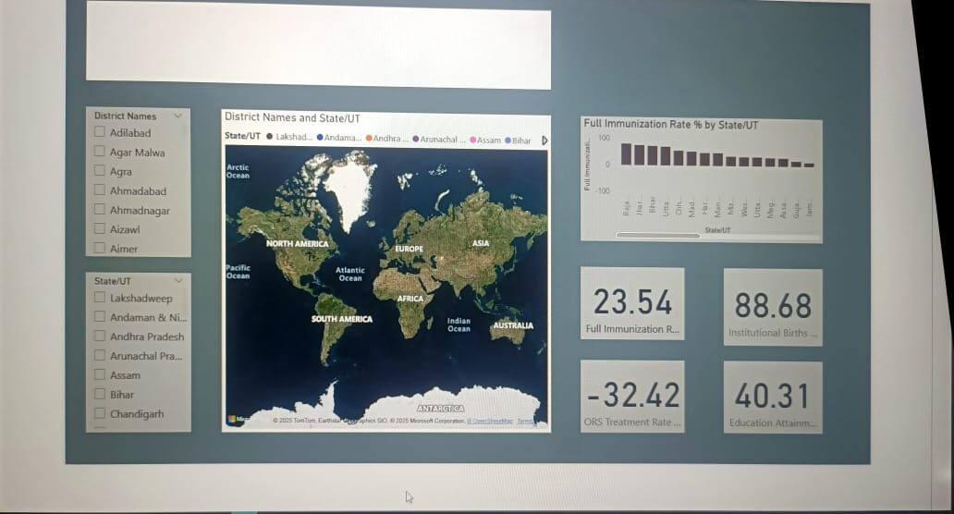
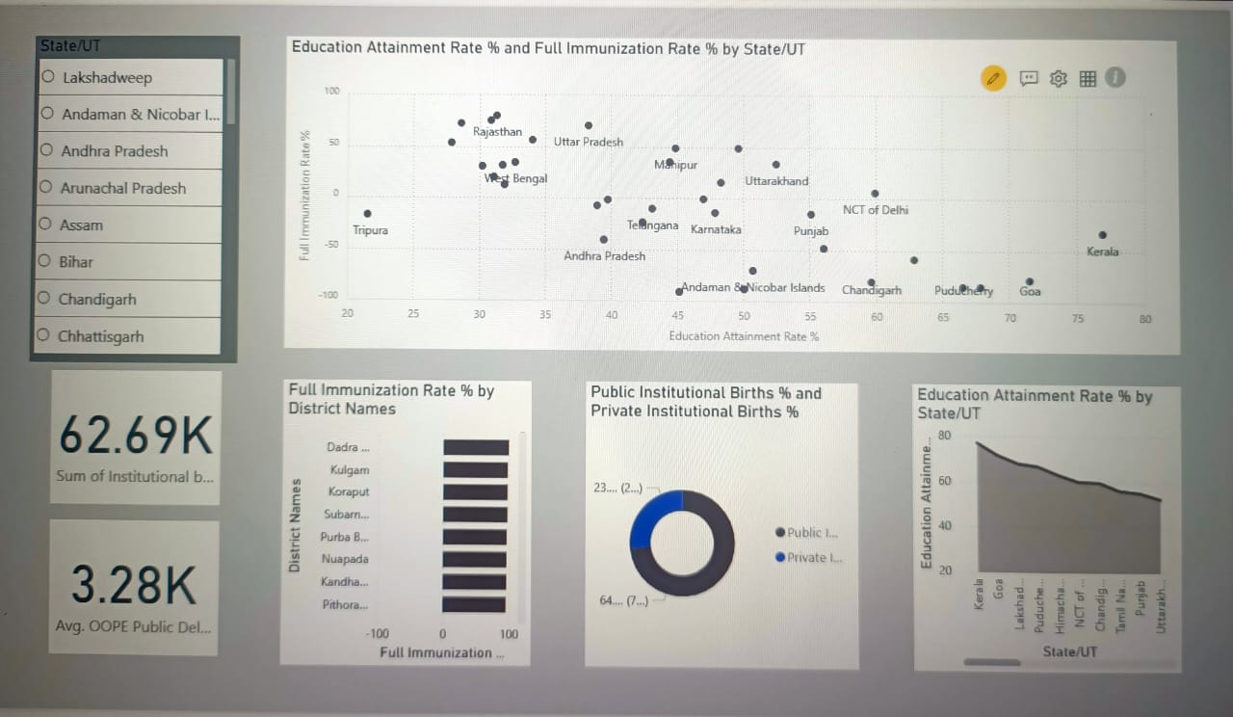
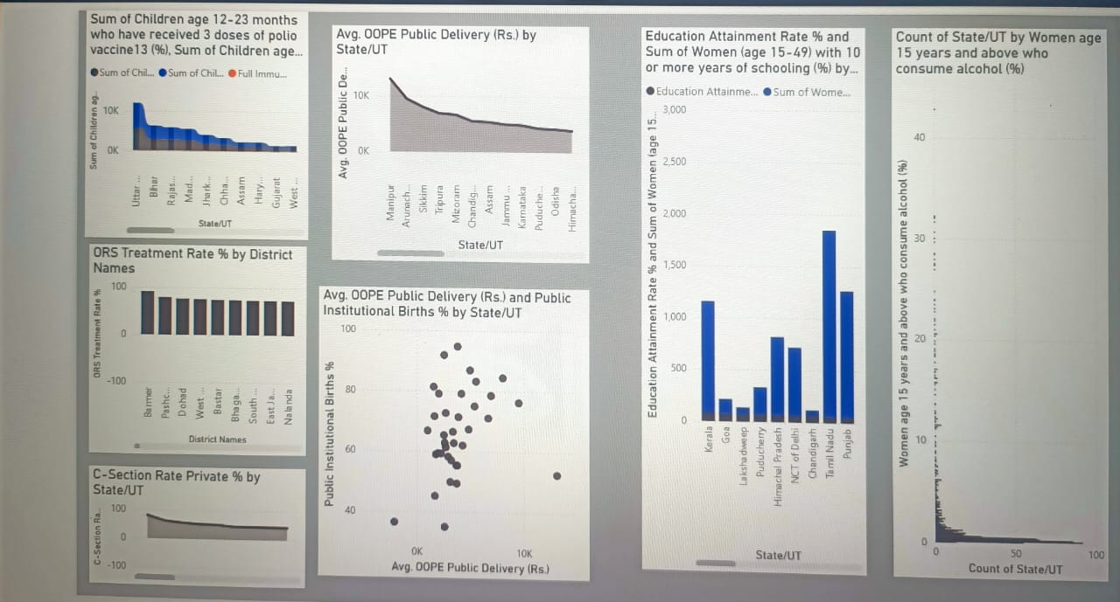

Slide 5
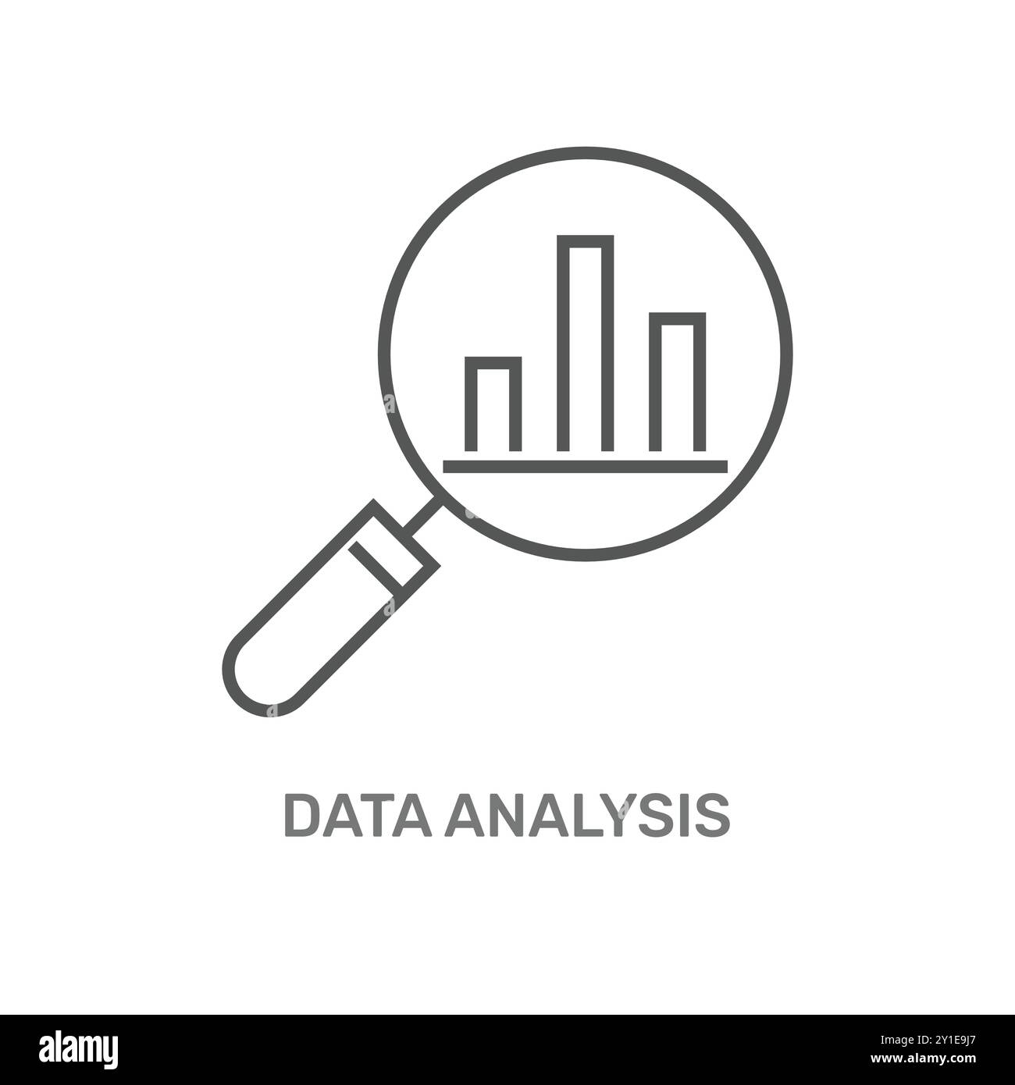
KEY INSIGHTS AND ANALYTICS
States with higher female education show better immunization and health outcomes.
Public healthcare costs (OOPE) are lower in southern states, showing stronger infrastructure.
3. . Maps and visuals highlight clear regional gaps in immunization and education.
4. Overall data is reliable, though some ORS values need verification.

Slide 6
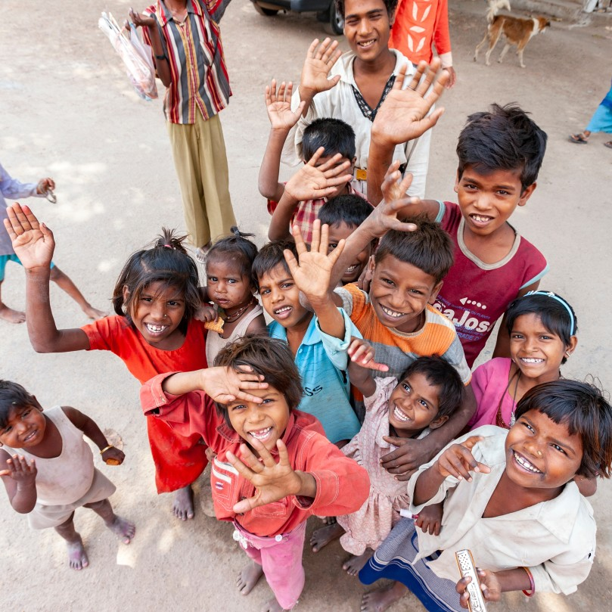
RECOMMENDATION OR BUSINESS IMPLICATION
Promote women’s education and vaccination awareness to improve overall health outcomes.
Strengthen public healthcare services to reduce costs and dependence on private hospitals.
Target underperforming states and districts with special health and education programs.
Ensure accurate and reliable data for better health and policy planning.
Build public–private partnerships to expand affordable and quality healthcare access.

Slide 7
CONCLUSION
Many states show gaps in health and education, especially where women’s education is low
Poor immunization and high healthcare costs remain major concerns in several regions.
People depend more on private hospitals due to weak public healthcare services.
Promoting women’s education, improving healthcare, and fixing data issues can solve these problems.
Strong public–private partnerships can improve access, reduce costs, and boost overall development.

Slide 8
THANK YOU

